Slide 1
Code Review Training Course. Part 5b: Mobile Application
For VIB only
namhabach@gmail.com

Slide 2
Outline
1
2
3
Mobile Application Risk
iOS Structure
Android Structure
4
Code Review

Slide 3
iOS Structure

Slide 4
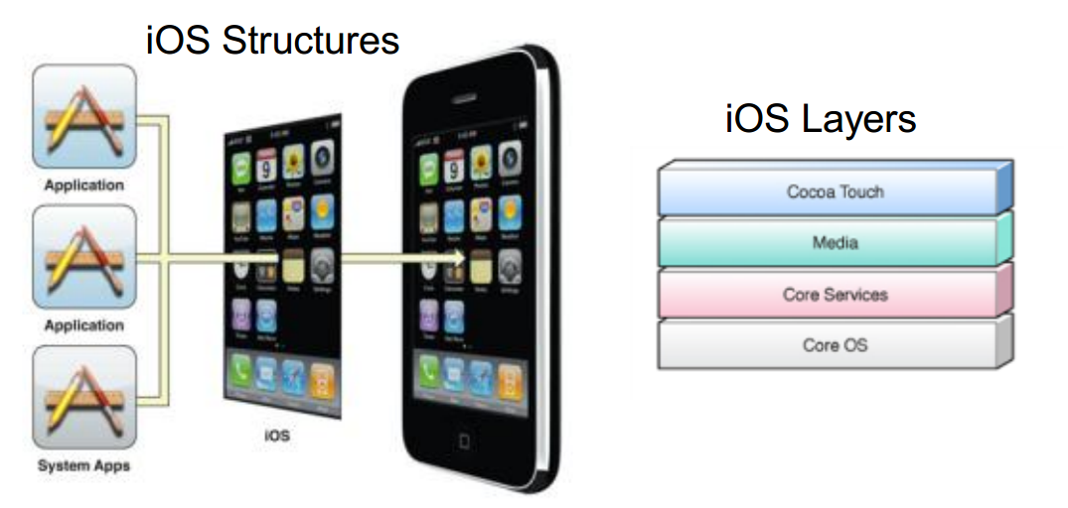
iOS in a nutshell

Slide 5
Cocoa Touch Layer
Key framework for building an Application
Key Functionalit
Storyboards Document Support
Multitasking Printing
Data Protection Apple Push Notification
Local Notifications Gesture Recognizers
File-Sharing Support Peer-to-Peer Services
Standard System View External Display Support

Slide 6
Media Layer
Layer consist of four major technologies -
Graphics Technologies
Audio Technologies
Video Technologies
AirPlay

Slide 7
Core Services Layer
Have core Operating System features
iCloud Storage (Documents & Key-Value data)
Automatic Reference Counting
Block Objects
Grand Central Dispatch
In-App Purchase
SQLite
XML Support

Slide 8
Core OS Layer
The Core OS layer contains the low-level features that most other technologies are built upon
Even if you do not use these technologies directly in your applications, they are most likely being used by other frameworks
Core OS layer is responsible for hardware communication

Slide 9
Core OS Layer
This layer has couple of important Security Framework along with framework to perform math calculation, third party hardware communication, Bluetooth communication, threading, networking, File System access, Standard I/O, Bonjour, DNS and Memory allocation.

Slide 10
Android

Slide 11
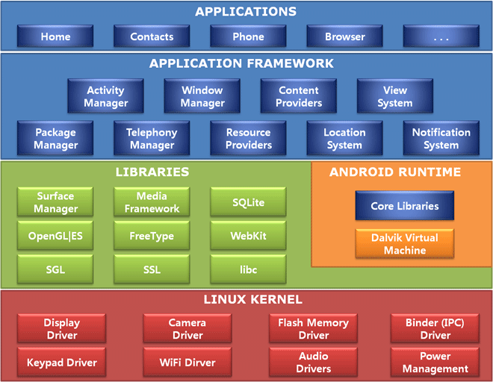
Android Structure

Slide 12
Android
Store - Android Market
UI – Java Application Framework
Browser – Webkit
Graphics – OpenGL
Language – Java
VM – Dalvik VM

Slide 13
Mobile Application Risk

Slide 14
Mobile Application Risk
Insecure Storage
Insecure Network Communication
PII Information Leakage
Hardcoded Secrets
Language Specific Issues
SQL Injection in Local database
Logical Issues

Slide 15
Insecure Storage

Slide 16
Insecure Storage
Why application needs to store data
Ease of use for the user
Popularity
Competition
Activity with single click
Decrease Transaction time
Post/Get information to/from Social Sites
9 out of 10 applications have this vulnerability

Slide 17
Insecure Storage
How attacker can gain access
Wifi
Default password after jail breaking
Physical Theft
Temporary access to device

Slide 18
Insecure Storage
What information we usually find
Authentication Credentials
Authorization tokens
Financial Statements
Credit card numbers
Owner’s Information – Physical Address, Name,
Phone number
Social Engineering Sites profile/habbits
SQL Queries

Slide 19
Insecure Network Communication

Slide 20
Insecure Network Communication
Important to encrypt data in the transmission
Easy to perform MiM attacks as Mobile devices uses untrusted network i.e open/Public WiFi, HotSpot, Carrier’s Network
Application deals with sensitive data i.e.
Authentication credentials
Authorization token
PII Information (Privacy Violation) (Owner Name, Phone number, UDID

Slide 21
Insecure Network Channel
Can sniff the traffic to get an access to sensitive data
SSL is the best way to secure communication channel
Common Issues
Does not deprecate HTTP requests
Allowing invalid certificates
Sensitive information in GET requests

Slide 22
PII Information Leakage
Application usually have access to user’s private information i.e. Owner Name, Location, Physical Address, AppID, Phone Number
This information needs to be handled very carefully as per the law in some countries
Storing this information in plain text is not allowed in some countries

Slide 23
Hardcoded Secrets

Slide 24
Hardcoded Secrets
Easiest way for developer to solve complex issues/functionality
Attacker can get this information by either reverse engineering application or by checking local storage

Slide 25
Language Specific Issues

Slide 26
Language Specific Issues
Application in iOS are developed in Objective C language which is derived from classic C language
Along with this derivation, it also derives security issues in C language i.e. overflow attacks

Slide 27
What Are Buffer Overflows (BOs)?
External data is larger than the destination
Overflowing the destination tramples some sensitive, in-memory construct that determines execution flow
Causing the application to change execution flow
To the attacker’s code that is included in the data
Cause: Trusting input
C/C++ code the most common victim
Direct access to memory

Slide 28

Stack Buffer Overflows at Work
All determine execution flow
Function return address
Exception Handlers
Function Pointers
Virtual Methods
Buffers
Other vars
EBP
EIP
Args
void func(char *p, int i) {
int j = 0;
CFoo foo;
int (*fp)(int) = &func;
char b[128]; strcpy(b,p);
}
0wn3d!
Bad things happen if *p points to data longer than b

Slide 29
Heap Overflows at Work
Write a DWORD
anywhere in memory
when block is free()’d
0wn3d!
Heap Block
Heap Block
Heap Block
Pointer to prior block
A₁
D₁
A₂
D₂
Pointer to next block
On block free:
D1 → [A1] D2 → [A2]

Slide 30
SQL Injection in Local database

Slide 31
SQL Injection in Local database
Most Mobile platforms uses SQLite as database to store information on the device
Using any SQLite Database Browser, it is possible to access database logs which has queries and other sensitive database information
In case application is not filtering input, SQL Injection on local database is possible

Slide 32
Information in Common Services

Slide 33
Information in Common Services
KeyBoard, Clipboard are shared amongst all the applications.
Information stored in clipboard can be accessed by all the application
Sensitive information should not be allowed to copy/paste in the application

Slide 34
Server Side Issues

Slide 35
Server Side Issues
Most Application makes server side calls to either web services or some other component. Security of server side component is equally important as client side
Controls to be tested on the server side – Security Control Categories for Server Side Application– Authentication, Access Controls/Authorization, API misuse, Path traversal, Sensitive information leakage,

Slide 36
Server Side Issues
Error handling, Session management, Protocol abuse, Input validations, XSS, CSRF, Logic bypass, Insecure crypto, DoS, Malicious Code Injection, SQL injection, XPATH and LDAP injections, OS command injection, Parameter manipulations, BruteForce, Buffer Overflow, HTTP response splitting, HTTP replay, XML injection, Canonicalization, Logging and auditing.

Slide 37
Logical Issues

Slide 38
Logical Issues
Authentication flags and privilege escalations at application layer
Critical parameter manipulation and access to unauthorized information/content
Business constraint exploitation
Identity or profile extraction
Denial of Services (DoS) with business logic

Slide 39
Questions?

Slide 40
#Enter to next part_>
End of Part 6

